Slide 1

OSCON – 7/27/2011
Andy Gregorowicz
The MITRE Corporation
© 2011 The MITRE Corporation - MITRE Public Release Case Number: 11-3190
Notes:
MITRE Public Release Case Number: 11-3190

Slide 2

Overview
Technical walkthrough
Implementation retrospective
Ways popHealth can be used

Slide 3
is a tool for examining patient populations against clinical quality measures
Notes:
Lead into next slide by asking what a quality measure is

Slide 4
Clinical Quality Measure
A test to see if a patient is receiving care in line with current medical standards
  Objective
  Evidence Based
  Health Importance
http://www.qualitymeasures.ahrq.gov/selecting-and-using/using.aspx

Slide 5
Example
Adult Weight Screening and Follow Up
Percentage of patients aged 18 years and older with a calculated BMI in the past six months or during the current visit documented in the medical record AND if the most recent BMI is outside parameters, a follow-up plan is documented.
Measure created by Quality Insights of Pennsylvania

Slide 6
Goals
Make executing quality measures easy
Work with existing Health IT systems
Provide an open implementation for the Health IT community
Notes:
Making it easy to run quality measures should lead to them being run more frequently, which should lead to improved care delivered
Working with existing systems is critical for deployment. If it can’t fit into the current Health IT infrastructure, organizations won’t use it.
Finally we want to provide an open source package that organizations can use as a drop in solution, take pieces of, or use as a reference to build their own.

Slide 7
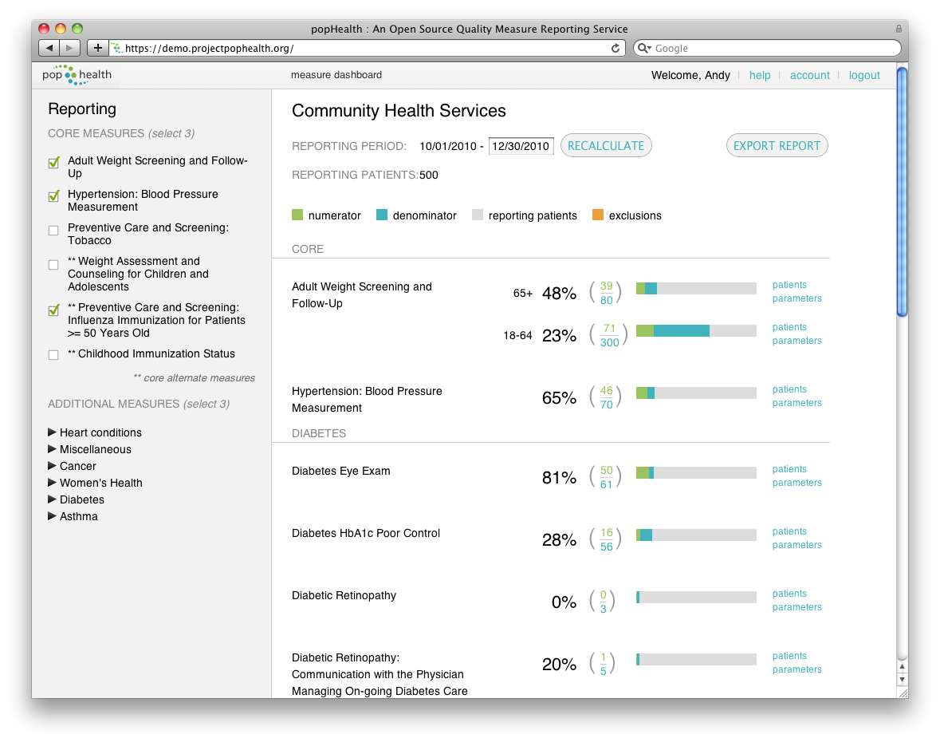
Notes:
popHealth makes running quality measures easy by providing an straightforward web application to view quality reports. This is the dashboard which lets providers quickly see how they are doing against quality measures that are important to them.

Slide 8
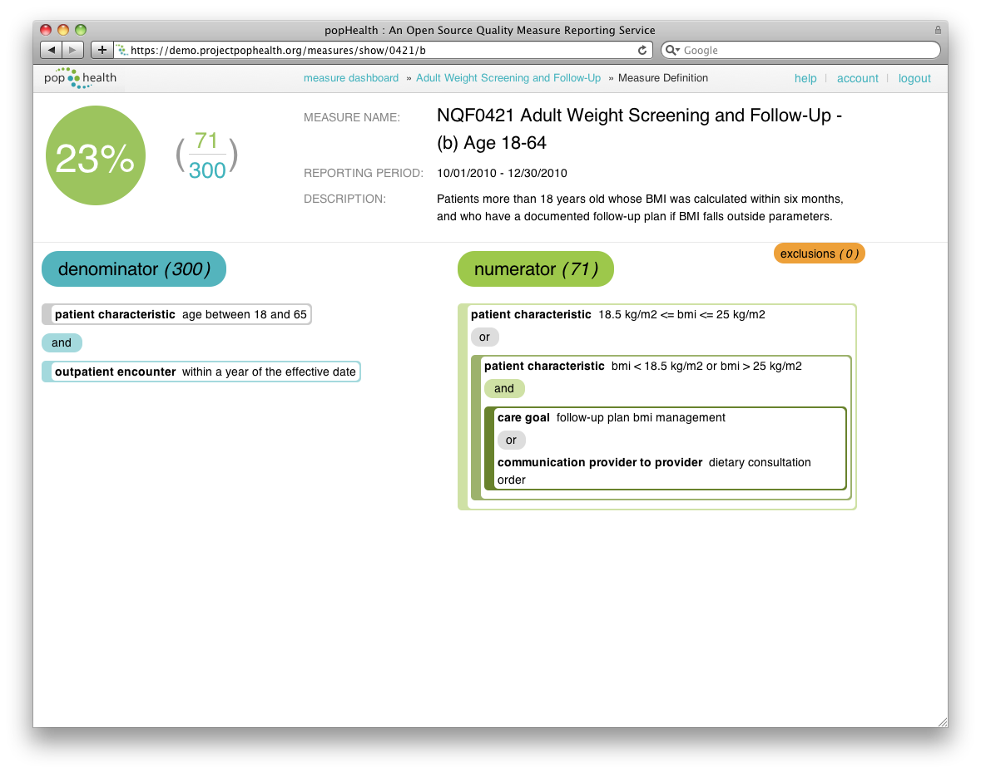
Notes:
popHealth provides a visual breakdown of each quality measure to help users understand what the measure is checking for.
Walk through the measure. Explain how these measures are numerator, denominator, exclusions.

Slide 9
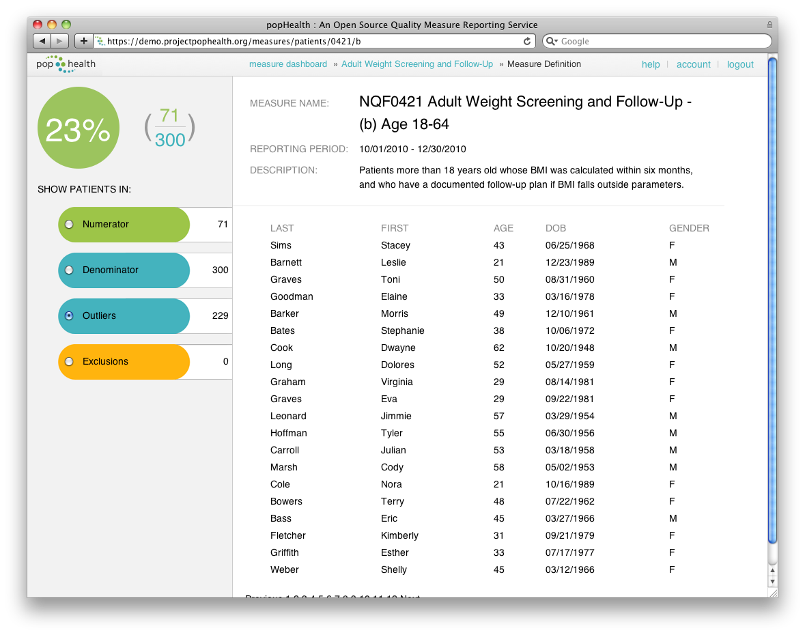
Notes:
popHealth also shows what patients fall into numerator, denominator and exclusions.
This view shows the outliers. These are the people who are in the denominator, but don’t meet the standard of care to qualify for the numerator. This lets providers find the patients they need to follow up with.
These are not real patients. This view was generated from synthetic data.

Slide 10
works with existing systems
Many electronic health record systems can export a patient summary
  It’s required for Stage 1 Meaningful Use
These patient summaries are in one of two XML based formats
  ASTM Continuity of Care Record (CCR)
  HITSP C32

Slide 11
ASTM CCR / HITSP C32
Personal Information
Language Spoken
Support
Healthcare Provider
Insurance Provider
Allergy/Drug Sensitivity
Condition
Medication
Pregnancy
Advance Directive
Immunization
Vital Sign
Result
Encounter
Procedure
Family History
Social History
Medical Equipment
And more…

Slide 12
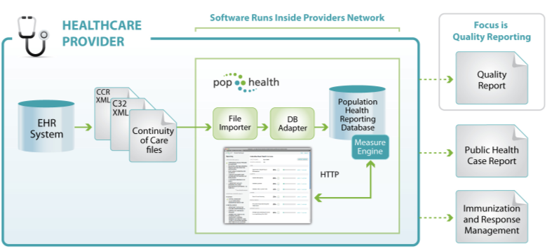
workflow
Notes:
A provider’s EHR exports the patient summaries in C32 or CCR format. They are then sent to popHealth via HTTPS POST.
popHealh parses the data and generates the reports. They can be viewed via the web interface, or exported to PQRI, an XML format for quality reports.

Slide 13
is open
Apache 2 License
3 Main Repositories
  Web application
    https://github.com/pophealth/popHealth
  Quality Measures
    Licensed by the quality measure stewards
    https://github.com/pophealth/measures
  Quality Measure Engine
    https://github.com/pophealth/quality-measure-engine
Notes:
In the next slide, we’ll start to see how these all work together

Slide 14
Technical Walkthrough

Slide 15
implementation stack
Ruby on Rails
MongoDB
JSON / JavaScript

Slide 16
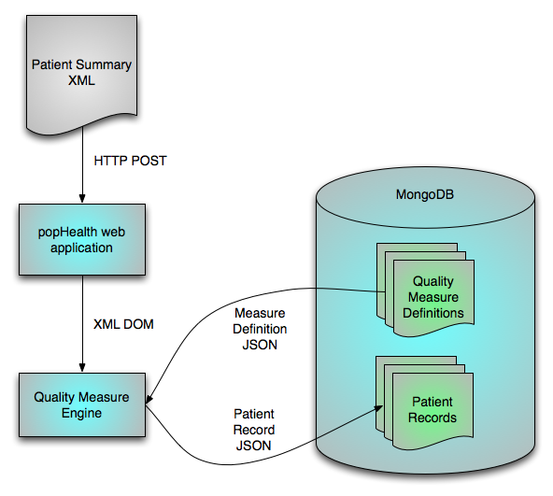
patient import
Notes:
Patient summary documents ate POSTed to the popHealth web application. This is an application built on Ruby on Rails. There, the XML is parsed with the Nokogiri XML library.
The Nokogiri document is passed to the Quality Measure Engine.
The Quality Measure Engine reads measure definitions from the database, which is MongoDB. It uses these measure definitions to create a de-normalized patient record that is stored in the database.

Slide 17
measure definitions
Basic metadata
  Name, description
Measure structure
Properties
  Pieces of data that need to be pulled from the patient record to calculate the measure
Notes:
In the next slide, we’ll start to see how these all work together

Slide 18
Measure Metadata
"endorser": "NQF",
"id": "0421",
"properties": "NQF_Retooled_Measure_0421.xlsx.json",
"name": "Adult Weight Screening and Follow-Up",
"description": "Patients more than 18 years old whose BMI
was calculated within six months, and who have a documented follow-up plan if BMI falls outside parameters.",
"steward": "QIP",
"category": "Core",

Slide 19
Measure Structure
"numerator": {
"or": [
{
"category": "Patient Characteristic",
"title": "22 kg/m2 <= BMI <= 30 kg/m2"
},
{
"and": [
{
"category": "Patient Characteristic",
"title": "BMI < 22 kg/m2 OR BMI > 30 kg/m2"
},
{
"or": [
{
"category": "Care Goal",
"title": "Follow up plan BMI management”
...
Notes:
This data drives the view you’ve already seen on of the measure description. We’ll show it again on the next slide.
The web application is built to handle levels of nesting so that this is visualized nicely.

Slide 21
Properties
"follow_up_plan_bmi_management_care_plan": {
"standard_category": "care_goal”,
"type": "array",
"items": {
"type": "number",
"format": "utc-sec"
},
"codes": [
{
"set": "ICD-9-CM”,
"values": [
"V65.3"
]
},
{
"set": "SNOMED-CT”,
"values": [
"169411000",
"170795002",
...
Notes:
This is one property of many for a measure. This one it related to a follow up plan for BMI management. The standard category lets us know what section of the patient summary XML we should look in.
We then have JSON Schema in “type” and “items” that let us know how we should store this property. In this case, it will be a list of dates. Each date will represent the time that a BMI management care plan has been established.
Finally we have code sets. These let us examine the patient summary XML and look at the specific care goals and determine which goals are BMI management. EHRs may use different code sets, so we need to be able to support multiples. Additionally, there may be more than one code acceptable for a specific property.

Slide 22
patient import

Slide 23
Parsing the patient summary
Summaries have sections
  Medications, vital signs, etc.
Sections have entries
  Coded description
  Time stamp
  Status (optional)
  Value (optional)
Notes:
Status can be used for things like conditions. For example, a condition might be resolved.
Value is used in results and vital signs. This is used to capture things like blood pressure readings.

Slide 24
High Level Patient Summary Example
Header
  Name: Sam Samer
  DOB: 10/18/1970
  Gender: Male
Vital Signs
  Systolic BP
    Code: 314443004 (SNOMED)
    Date: 7/17/2011
    Value: 132 mm[Hg]
Plan of Care
  BMI Management
    Code: V65.3 (ICD-9)
    Date: 4/19/2010
  Tobacco Cessation
    Code: …
    …
Medications
  …
2 Entries in the Plan of Care section
1 matches the example measure property

Slide 25
Patient Record
{
"first": "Sam",
"last": "Samer",
"gender": "M",
"patient_id" : "104216",
"birthdate": 25142400,
"measures": {
"0421": {
"encounter_outpatient_encounter": [1271721600],
"bmi_physical_exam_finding": [{"value": 28,
"date": 1269043200}],
"follow_up_plan_bmi_management_care_plan": [1271721600]
}
}
}

Slide 26
patient record
JSON Document
Data is denormalized
  Embedded document per measure
Time stamps converted to seconds since epoch
  MongoDB 1.8 date types don’t work with dates before the epoch
  https://jira.mongodb.org/browse/SERVER-405
Notes:
In the next slide, we’ll start to see how these all work together

Slide 27
calculating quality measures
Built in the Quality Measure Engine
Uses MongoDB’s MapReduce capabilities
Map functions stored as part the measure definition
Reduce is the same for all measures
Notes:
In the next slide, we’ll start to see how these all work together

Slide 28
Example Map JavaScript
var effective_date = <%= effective_date %>;
var latest_birthdate = effective_date - 18*year;
var earliest_birthdate = effective_date - 65*year;
var earliest_encounter = effective_date - year;
var population = function() {
var correct_age = inRange(patient.birthdate, earliest_birthdate, latest_birthdate);
return (correct_age);
}
var denominator = function() {
return inRange(measure.encounter_outpatient_encounter, earliest_encounter, effective_date);
}

Slide 29
Example (cont.)
var numerator = function() {
return weight_numerator(measure, 18.5, 25);
}
var exclusion = function() {
return weight_exclusion(measure, earliest_encounter,
effective_date);
}
map(patient, population, denominator, numerator, exclusion);

Slide 31
Implementation Retrospective

Slide 32
Benefits of JavaScript M/R
Our team has found it easier to work with than writing SQL queries
  YMMV
JavaScript has great development tools built right into browsers

Slide 33
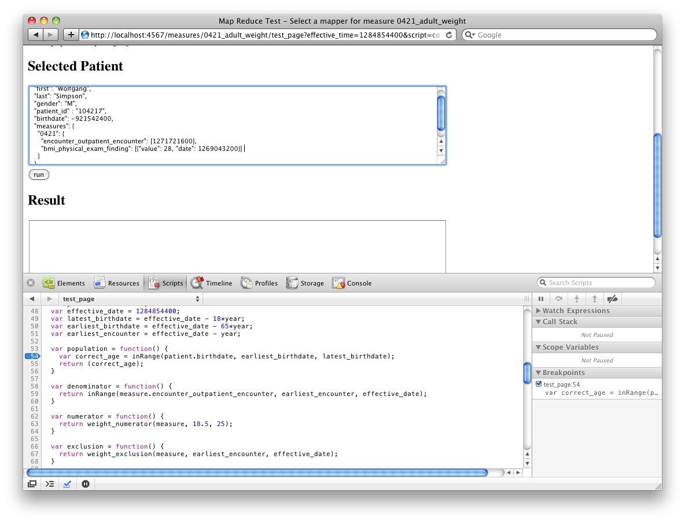
Notes:
We built a small Sinatra app to debug our map reduce code

Slide 34
Testing Map/Reduce in the Browser
Build a small app
Replicating the MongoDB environment is easy
  Mock emit()
  Inject the document
    Underscore.js bind()
More details: http://gregorowicz.blogspot.com/2010/12/debugging-mapreduce-in-mongodb.html

Slide 35
Downsides
MongoDB’s MapReduce implementation is single threaded per instance
  Sharding isn’t often practical for our data size
Using JavaScript frameworks (like Underscore.js) can be tricky
  MongoDB’s system.js collection doesn’t handle this well

Slide 36
Ways popHealth Can Be Used

Slide 37
as a web app
Rails 3.0 application
  Follow the Install instructions
As a VMWare VM
  Preconfigured on Ubuntu
  http://projectpophealth.org/download.html
Notes:
In the next slide, we’ll start to see how these all work together

Slide 38
as a library
Quality Measure Engine is a ruby gem
3 main classes to work with
  QualityMeasure
  PatientImporter
  QualityReport
Notes:
In the next slide, we’ll start to see how these all work together

Slide 39
for measure developers
Measures are defined in JavaScript
You can add your own
Notes:
In the next slide, we’ll start to see how these all work together

Slide 40
Thank You!
http://projectpophealth.org/

Slide 41
Backups

Slide 42
What is a C32 like?

Slide 43
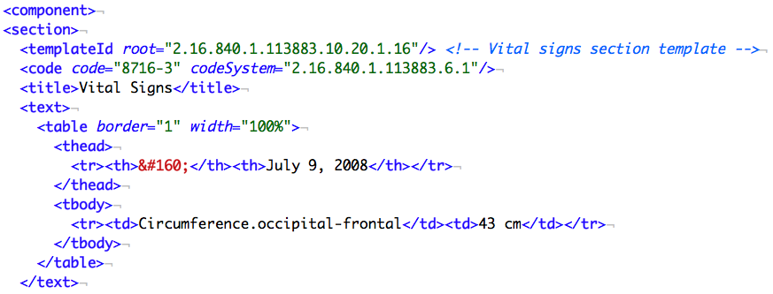
Notes:
Example narrative section of a C32

Slide 44
Section Identification
Notes:
This is the start of a CDA section with a templateId to indicate that this is a Vital Signs section

Slide 45
Narrative Block
Notes:
HTML-like section to facilitate easy human readability and styling with XSL

Slide 46
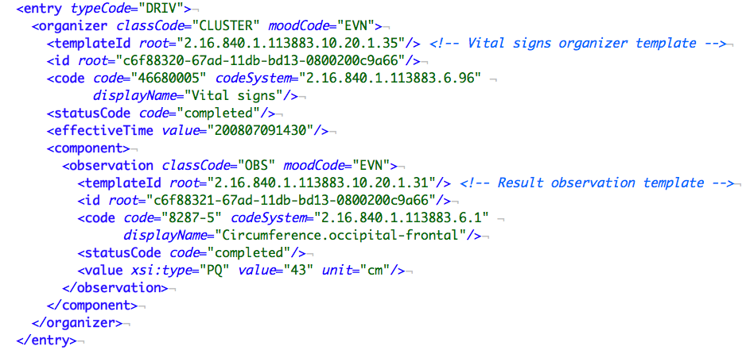
Coded Information Container
Notes:
Coded portion of the C32 head circumference example

Slide 47
Organizer
Notes:
Vital signs should be grouped by organizer
Since organizers are generic, a templateId must be provided to show what kind of organizer it is

Slide 48
Date and Status
Notes:
Vital signs should be grouped by organizer
Since organizers are generic, a templateId must be provided to show what kind of organizer it is

Slide 49
Observation
Notes:
Observation, the recording of the vital sign
Since observations are generic, a templateId must be provided again to identify this as a result (vital sign) observation

Slide 50
ID
Notes:
Unique id for this object in the CDA

Slide 51
Code
Notes:
The coded term for the vital sign. In this case, it is a LOINC code for a head circumference measurement

Slide 52
Value
Notes:
The value of this observation with the units specified.

Slide 53
... same data in CCR

Slide 54
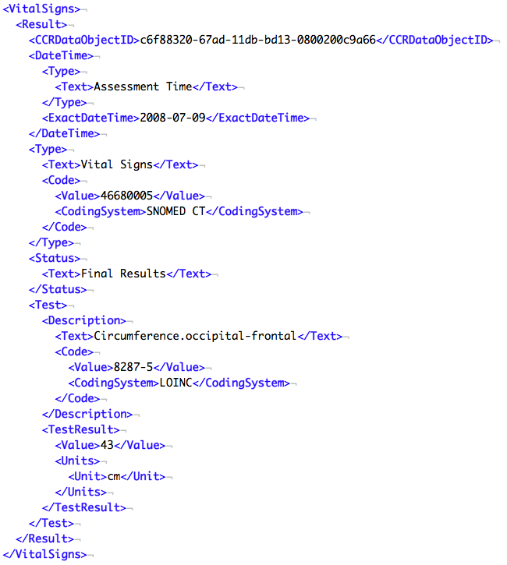
Notes:
CCR is much simpler. The tags have more specific meaning.

